Slide 1
Digital Portfolio
STUDENT NAME:
REGISTER NO AND NMID:
DEPARTMENT:
COLLEGE: COLLEGE/ UNIVERSITY
Immaculate college for women /annamalai university
Leela. V
STUDENT NAME:
REGISTER NO AND NMID:
DEPARTMENT:
COLLEGE: COLLEGE/ UNIVERSITY
Immaculate college for women /annamalai university
Id16277F1647D70A58D4808722953Ac
Leela. V
Bsc computer science
Id177F1647D70A58D4808722953Ac

Slide 2
PROJECT TITLE
Creative student portal development profoilo using FWD

Slide 3


AGENDA
Problem Statement
Project Overview
End Users
Tools and Technologies
Portfolio design and Layout
Features and Functionality
Results and Screenshots
Conclusion
Github Link
3/21/2024 Annual Review

Slide 4

PROBLEM STATEMENT
problem statement is a clear and concise description of an issue that needs to be addressed. It defines the gap between the current state and the desired future state, outlining the problem, its impact, and why it's important to solve. It's a crucial step in problem-solving, project management, and research, helping to focus efforts and align stakeholders.
problem statement is a clear and concise description of an issue that needs to be addressed. It defines the gap between the current state and the desired future state, outlining the problem, its impact, and why it's important to solve. It's a crucial step in problem-solving, project management, and research, helping to focus efforts and align stakeholders.

Slide 5

PROJECT OVERVIEW
project overview is a concise, one-page summary that provides a high-level description of a project's goals, objectives, scope, timeline, budget, and expected

Slide 6

WHO ARE THE END USERS?
End users are the individuals or entities that directly use a product, service, or system to accomplish tasks or meet their needs, rather than the

Slide 7

TOOLS AND TECHNIQUES
tool is a physical instrument or digital program used to perform a task, such as a hammer, a questionnaire, or software like a Gantt chart. A technique is the method, procedure, or way of using a tool or a set of tools to achieve a desired outcome, such as hammering a nail straight or using a decision matrix to rank ideas. Tools execute, while techniques guide execution.

Slide 8
Features and Functionality
Features are the tangible attributes or components of a product or service, such as a smartphone's camera or a software's user interface. Functionality describes the actions and overall capabilities of the product or service, including how well it performs its tasks to fulfill user needs and provide value. In essence, features are the "what" a product has, while functionality is the "how well" it does things.

Slide 9
POTFOLIO DESIGN AND LAYOUT
Potello" likely refers to a typo for "Portello," which can be an Italian architectural term or a brand name for design products. "Portello" refers to Portello Global, a company specializing in custom gates and doors, and a side table by the brand Leolux. It also refers to the PortelloPark in Milan, Italy, a notable landscape architecture project. Therefore, the "potello design and layout" refers to the aesthetic and structural design of gates, doors, tables, or parks from one of these entities.
9

Slide 10
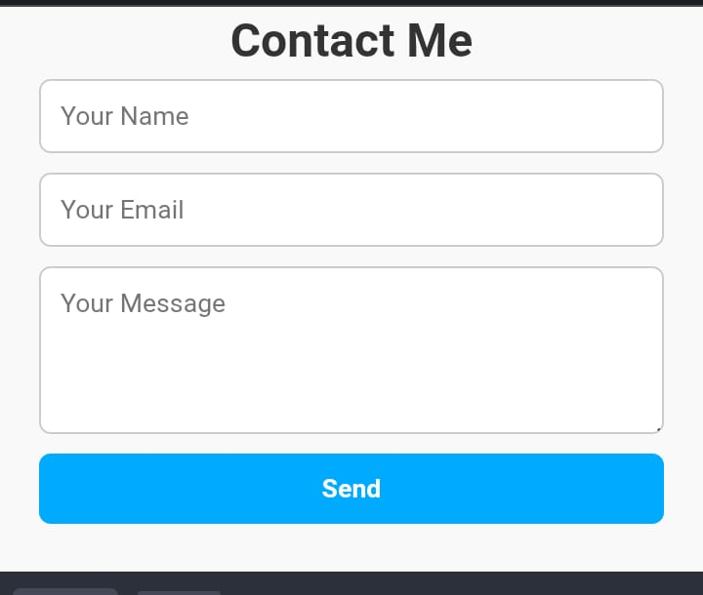

RESULTS AND SCREENSHOTS
3/21/2024 Annual Review
10

Slide 11
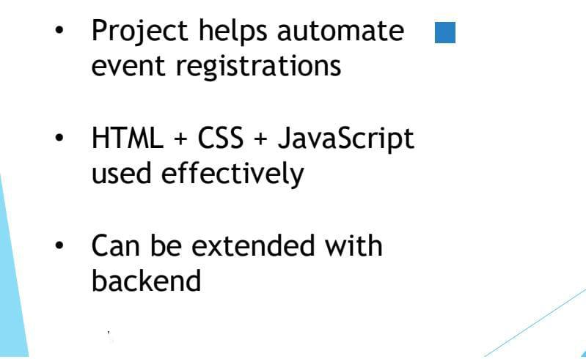
CONCLUSION
11

Slide 12
POTFOLIO DESIGN AND LAYOUT
12

